Slide 1
Gain on Sale of Assets

Slide 2
Overview
Sale of fixed assets – Revenue Stream
Gain on Sale = Sale price of a Fixed asset – Book Value of the Asset.
3 Major Variables to Identify:
Date Asset will be Sold
Sale Price of Asset at Sold Date
Book Value of Asset at Sold Date.
Properly forecasting revenue streams will allow us to fund capital investments.

Slide 3
Date of Sale
When will Customers turn in their vehicle?
End of term?
We will put the vehicle on a new lease at end of term?
Historical outlier customer behavior?
Why did a customer turn in a vehicle?
Economic reasons?
Better Deal?
Wants new vehicle on the road?

Slide 4
Sale Price of Asset
What qualities of a vehicle drive sale price?
Market Appetite
Mileage of Vehicle
Make of Vehicle/style
Location of sale?
Multiple Regression could be proper methodology

Slide 5
Book Value of Asset
Clean portfolio of assets to project Book Value
Operating Lease vs Direct Finance
Operating – Straight Line Depreciation
Direct Finance – Mortgage Style Depreciation
Forecast book value per depreciation type based on Projected Sale Date.

Slide 6
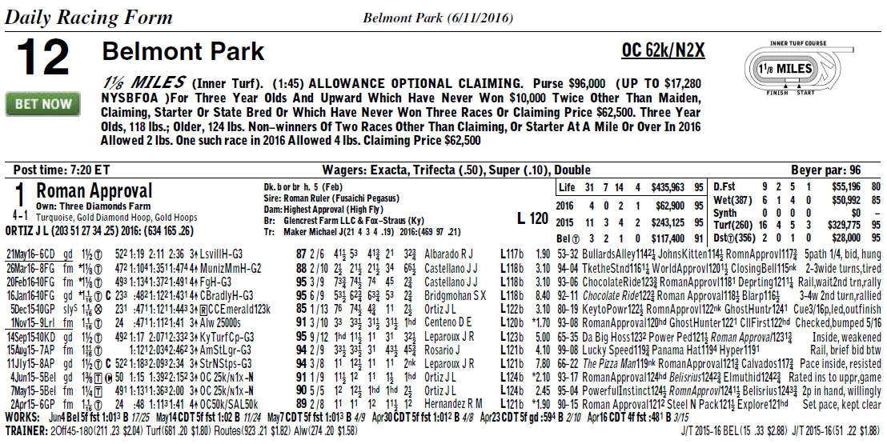
Secondary Idea…

